Slide 1


Marketing Team
Alejandro Swaby – Cervion Systems
Giovanna Acosta – Cervion Systems
Katie Coolidge – Essential Systems Solutions
Thomas Greenman – Skurla’s POS Solutions

Slide 2
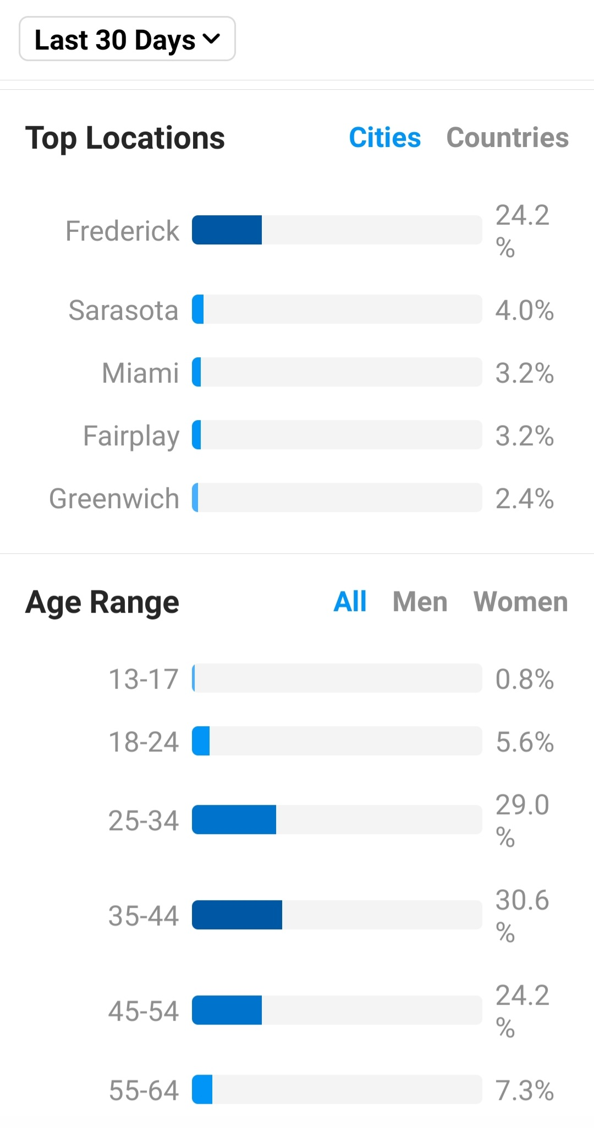


Social Media Support
Engagement
Ideas
Contact Information:
katie.coolidge@esspos.com
Free Pictures and Images

Slide 3

Social Media Links
Website:
https://www.edgeservpos.com/
Facebook:
https://www.facebook.com/edgeservpos
Instagram:
https://www.instagram.com/edge.serv/
Twitter:
https://twitter.com/edge_serv
LinkedIn:
https://www.linkedin.com/company/edgeserv-pos/
YouTube:
https://www.youtube.com/EdgeServPOS
Blog:
https://www.edgeservpos.com/blog
Contact Information:
katie.coolidge@esspos.com
Don’t Forget to Follow and Tag EdgeServ on Social Media!

Slide 4
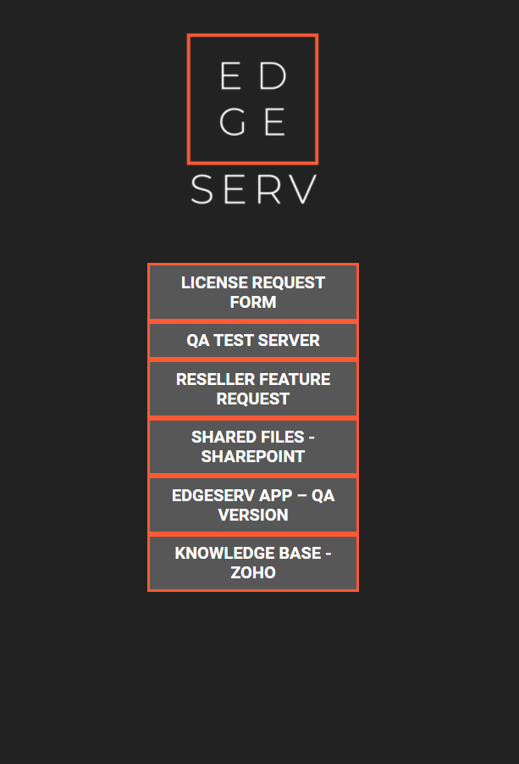
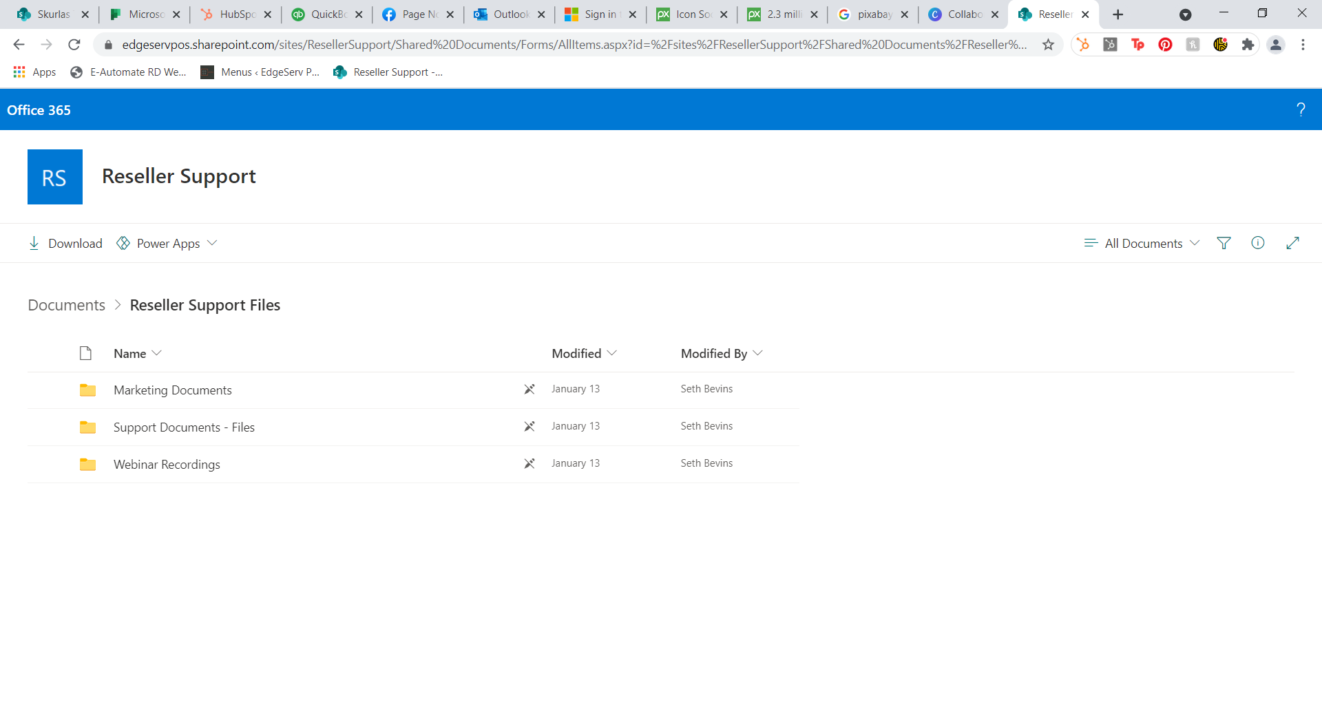
Social Media Links
https://links.edgeservpos.com/
Shared Files – SharePoint
Marketing Documents

Slide 5

Reseller Newsletter
Welcome to the EdgeServ Reseller Newsletter!
We are excited to launch our first newsletter!
We will be sharing general news, reseller announcements, marketing ideas and other relevant announcements.
https://www.edgeservpos.com/reseller_news

